Slide 1


Lesson 3 Crime and punishment
UNIT 2

Slide 2

Which word is missing?
POLICE
_______________________________ station
officer
car
helicopter
siren

Slide 3
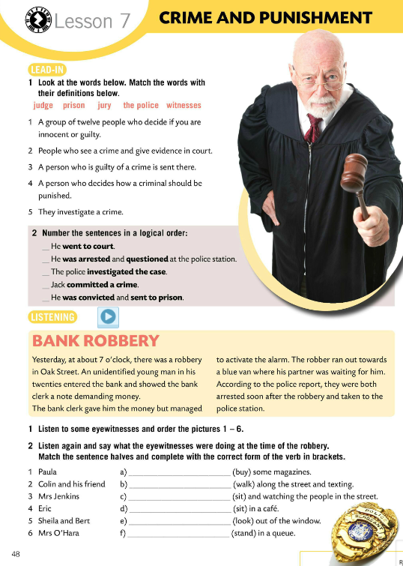
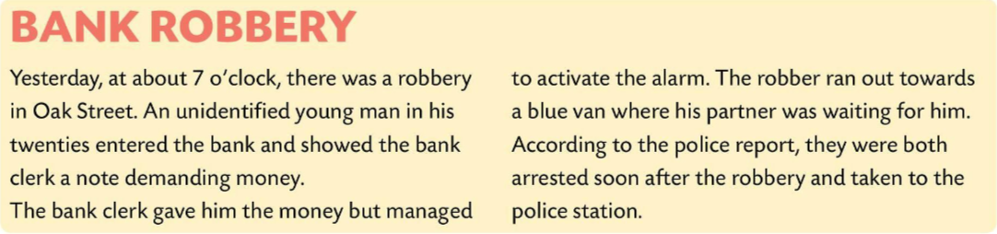
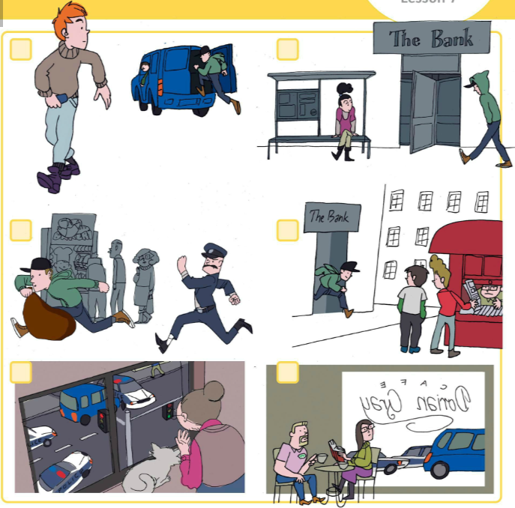
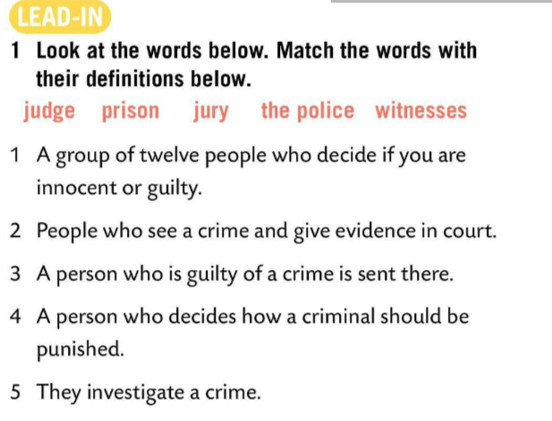
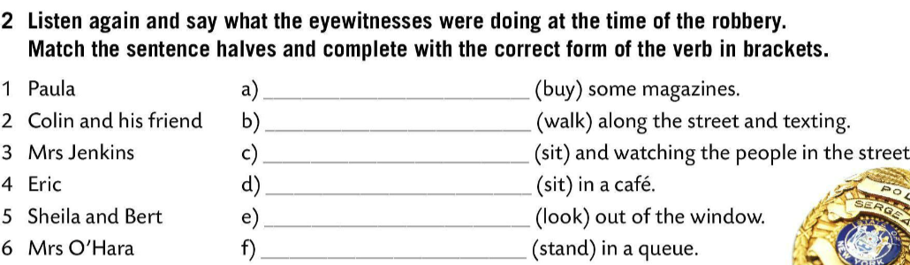
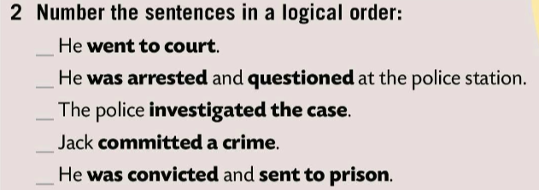



Match the words with their definition.
Check.
4
1
Number the sentences in a logical order.
jury
Check.
3
witness
2
Listen to some eyewitnesses. Put the pictures in the right order (1-6).
prison
judge
Listen again and check.
the police
6
5
Say what the eyewitnesses were doing at the time of the robbery. Match the sentence halves. Complete with the correct form of the verb in brackets.

Slide 4
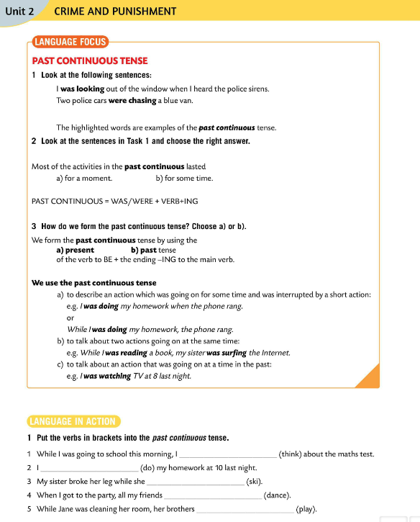
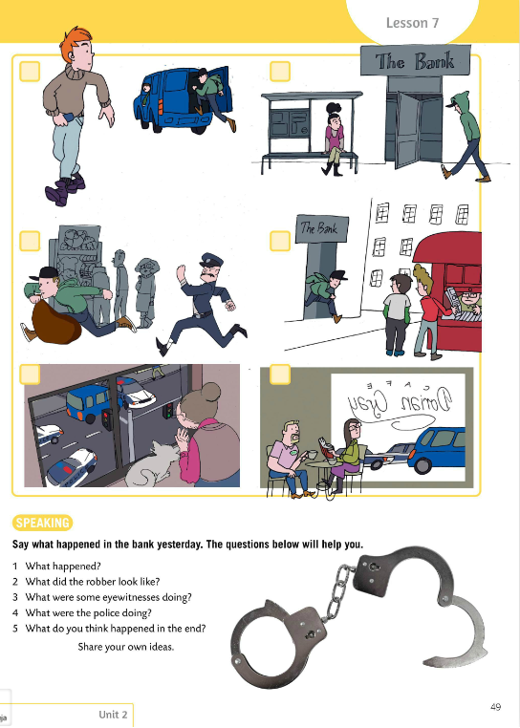
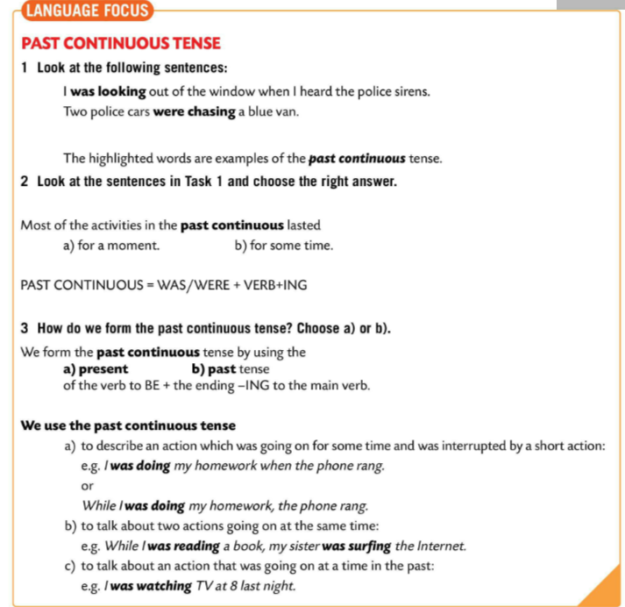
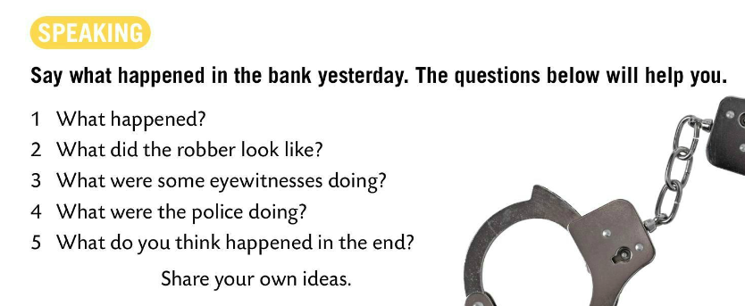
Say what happened in the bank yesterday. The questions below will help you.
LANGUAGE FOCUS
Task 1
The highlighted words in these sentences are examples of the PAST CONTINUOUS tense.
Task 2
Read once again sentences in Task 1 and choose the right answer.
Most of the activities in the past continuous lasted for some time.
Većina radnji u prošlom glagolskom vremenu past continuous su trajale neko vrijeme.
WAS/WERE + VERB + -ING = PAST CONTINUOUS

Slide 5
Task 3
How do we form past continuous tense? Choose a) or b).
Check.
Copy.
WAS/WERE + VERB + -ING = PAST CONTINUOUS
I was walking down the street when I met my friend.
They were dancing the whole evening.

Slide 6
LANGUAGE FOCUS
We use the past continuous tense to:
Glagolsko vrijeme past continuous koristimo za:
1 describe an action which was going on for some time and was interrupted by a short action.
…opisivanje neke prošle radnje koju je prekinula neka druga radnja iz prošlosti.
e.g. I was doing my homework when the phone rang. OR
While I was doing my homework, the phone rang.
2 talk about two actions going on at the same time.
…opisivanje dviju prošlih radnji koje su se događale istovremeno.
e.g. While I was reading a book, my sister was surfing the Internet.
3 …talk about an action that was going on at a time in the past
…opisivanje radnje koja je trajala neko vrijeme u prošlosti.
e.g. I was watching TV at 8 last night.

Slide 7

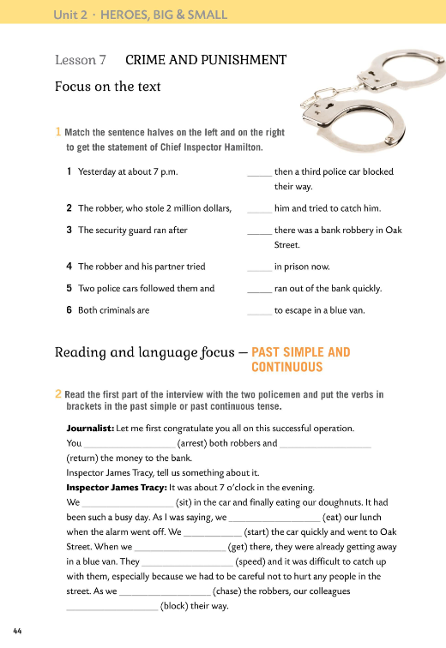
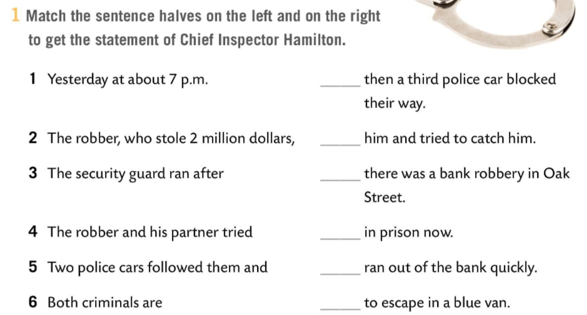
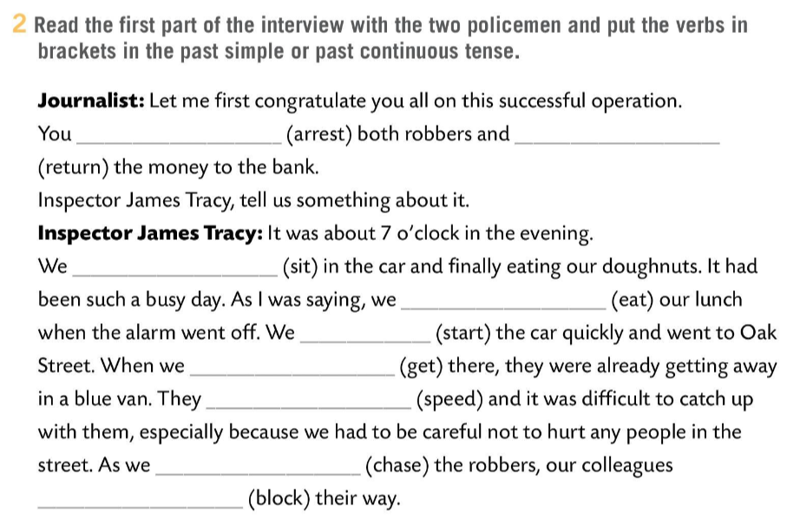
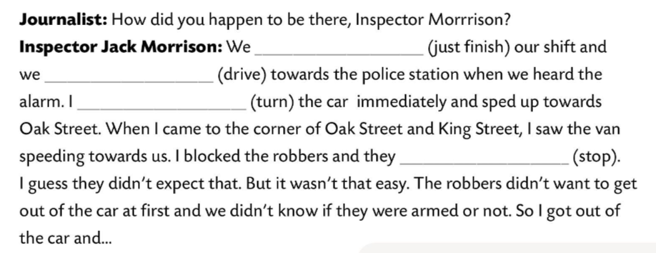
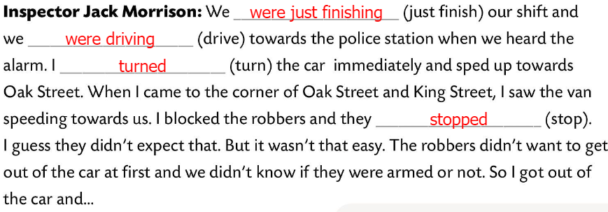
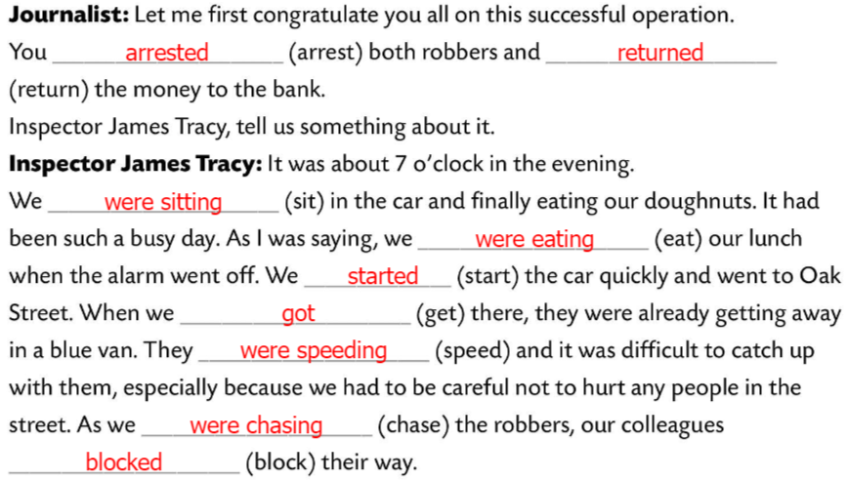

Workbook, p. 44
Match to get the statement of Chief Inspector Hamilton.
Check.
Read the first part of the interview with the two policemen.
Put the verbs in brackets in the past simple or past continuous tense.
Check.

Slide 8
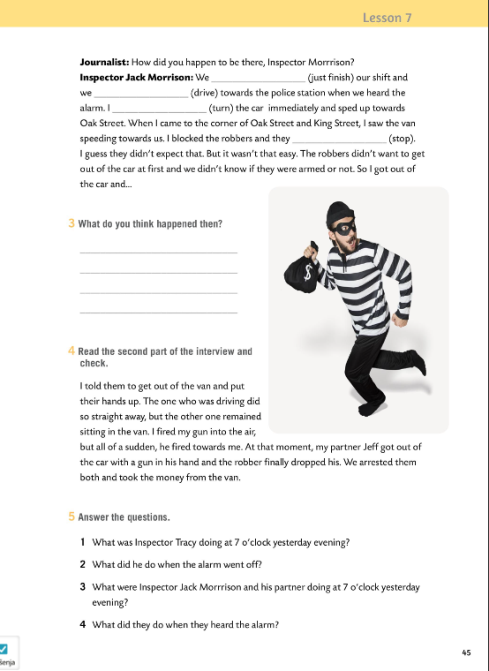
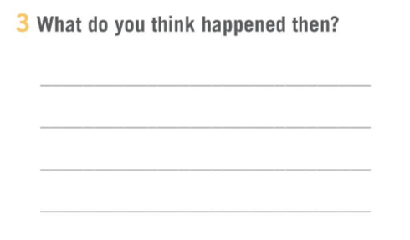
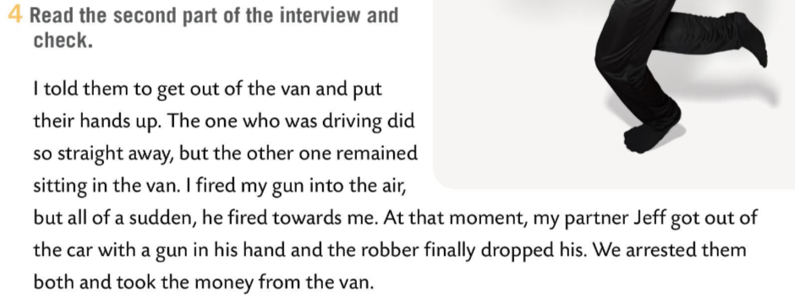
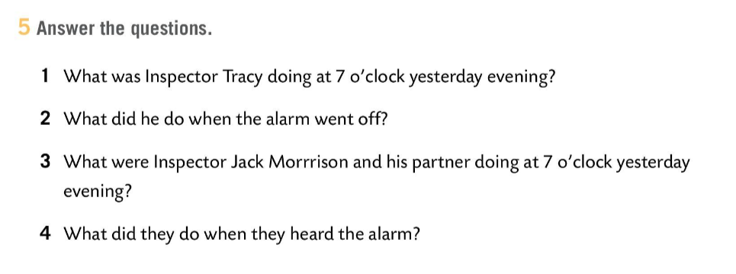
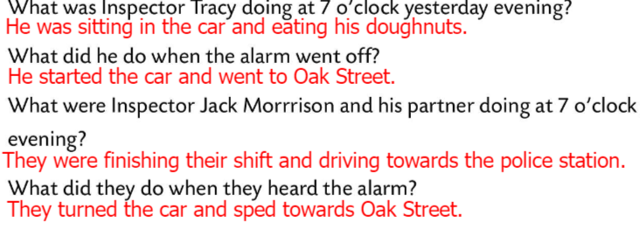
Workbook, p. 45
What do you think happened then?
Share your answers with the class.
Read the second part of the interview and check.
Answer the questions.
Check.

Slide 9
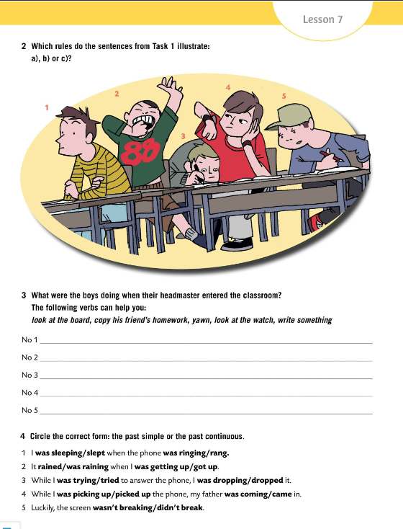
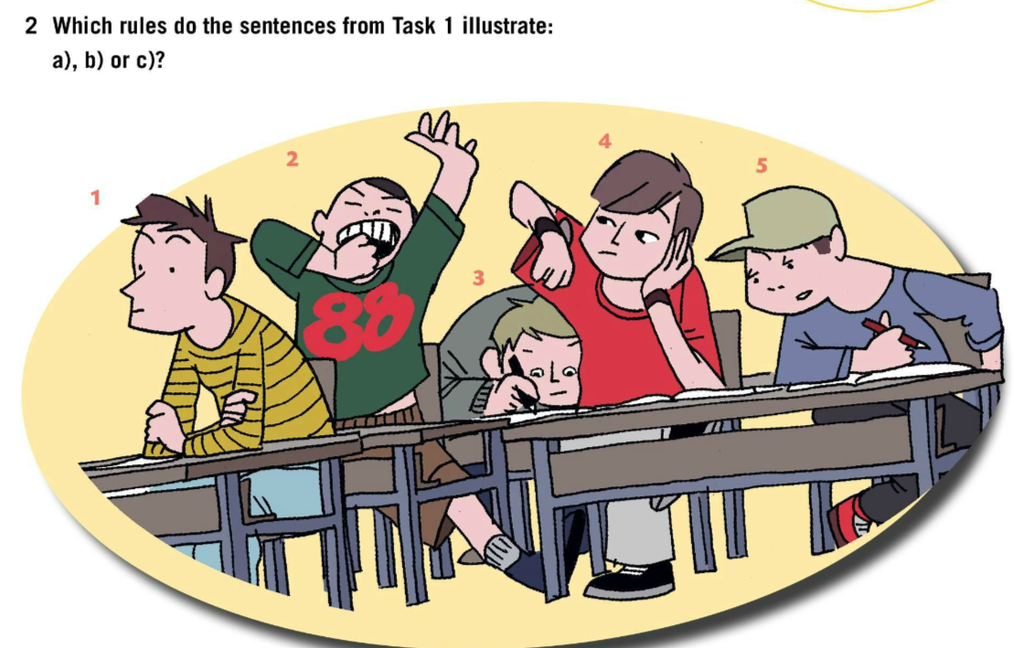
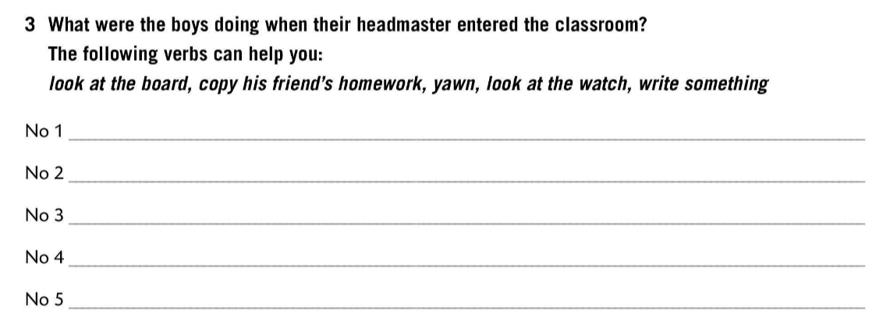
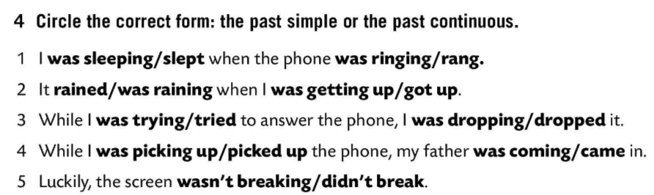
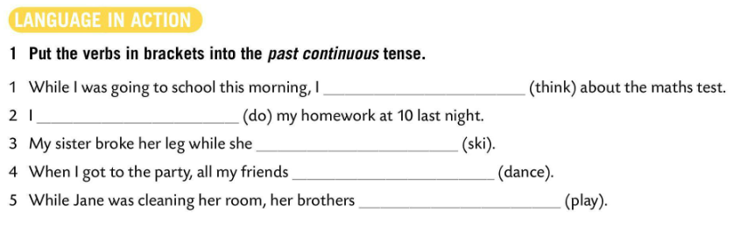
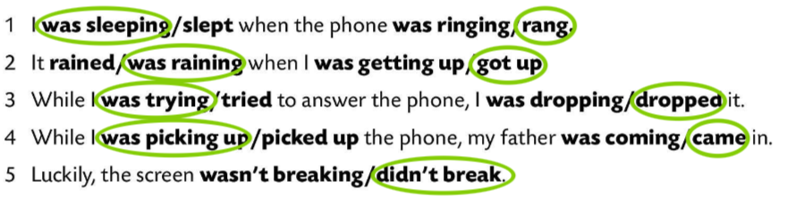
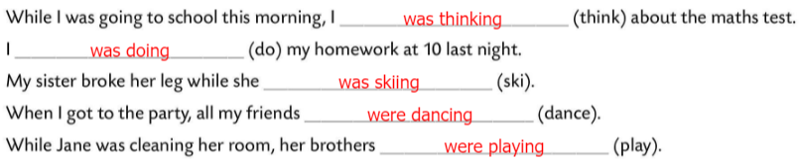
Put the verbs in brackets into the past continuous tense.
Check.
Which rules do the sentences from Task 1 illustrate?
Check.
a) 3, 4 b) 1, 5 c) 2
was looking at the board
was yawning
was writing something
was looking at the watch
What were the boys doing when their headmaster entered the classroom?
was copying his friend’s homework
Circle the correct form: the past simple or the past continuous.
Check.

Slide 10
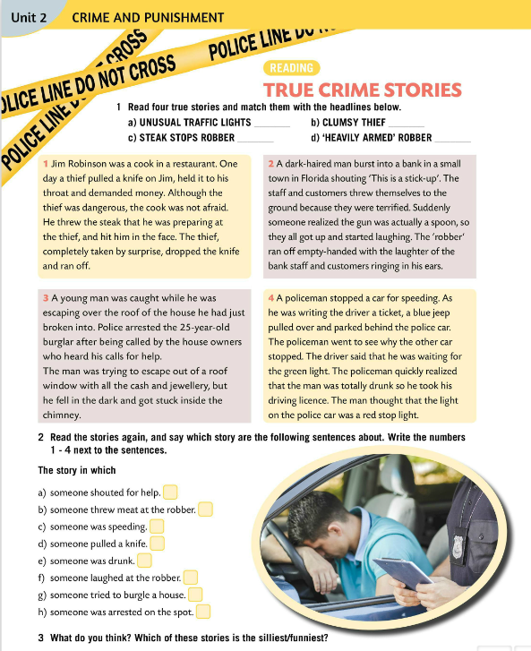
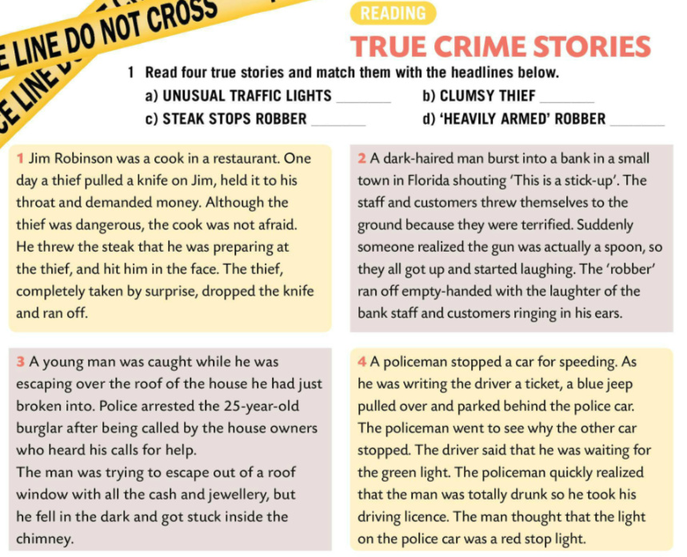
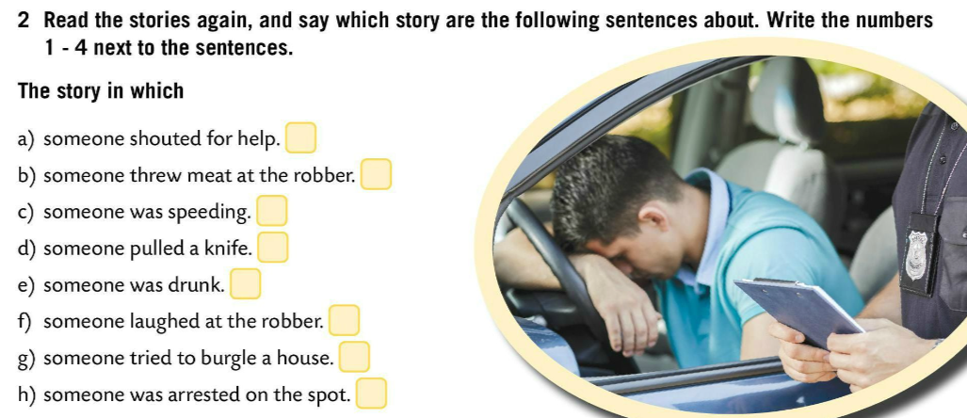
Read four true crime stories and match them with the headlines below.
Check.
4
3
1
2
Read again. Which story are the following sentences about? Write the numbers 1 – 4 next to the sentences.
3
1
4
1
4
2
3
3
Check.
What do you think? Which of these stories is the silliest/funniest?

Slide 11
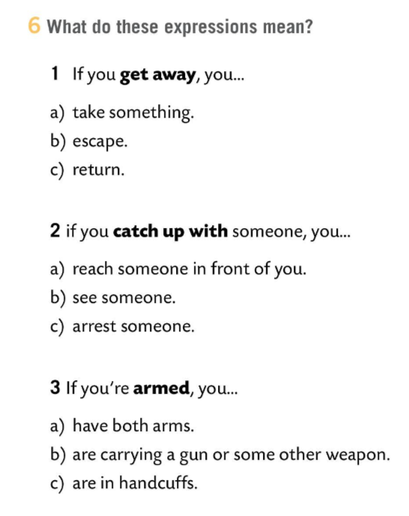
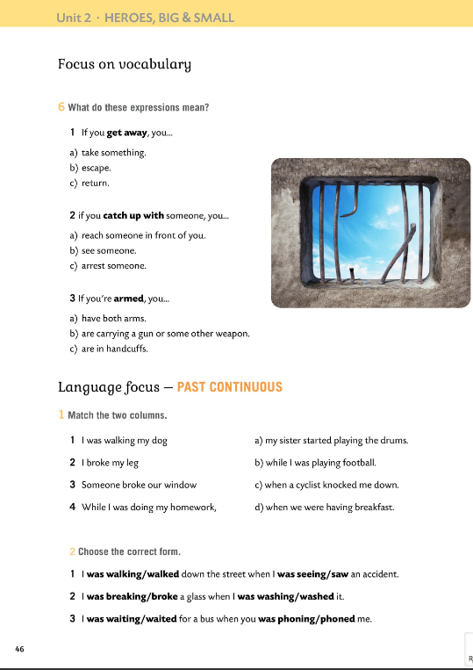
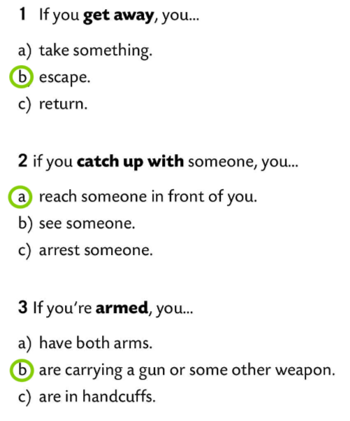
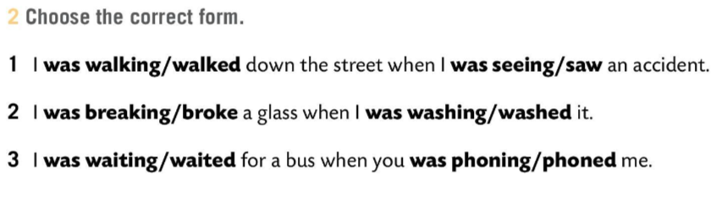
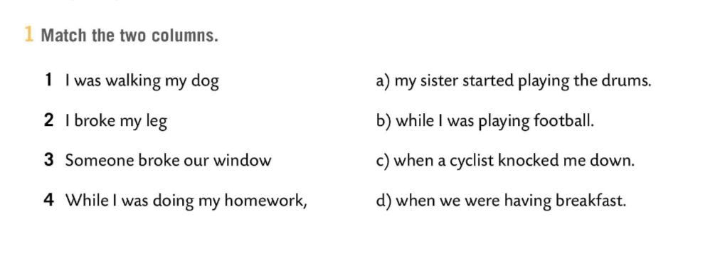
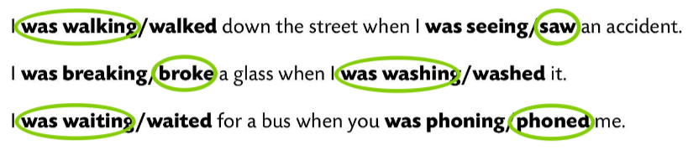
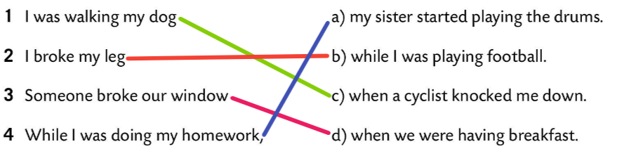
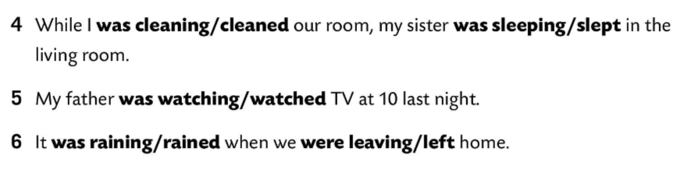
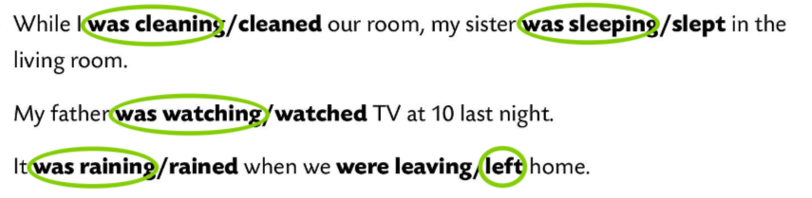
Workbook, p. 46
What do these expressions mean?
Check.
Match the two columns.
Check.
Choose the correct form.
Check.

Slide 12
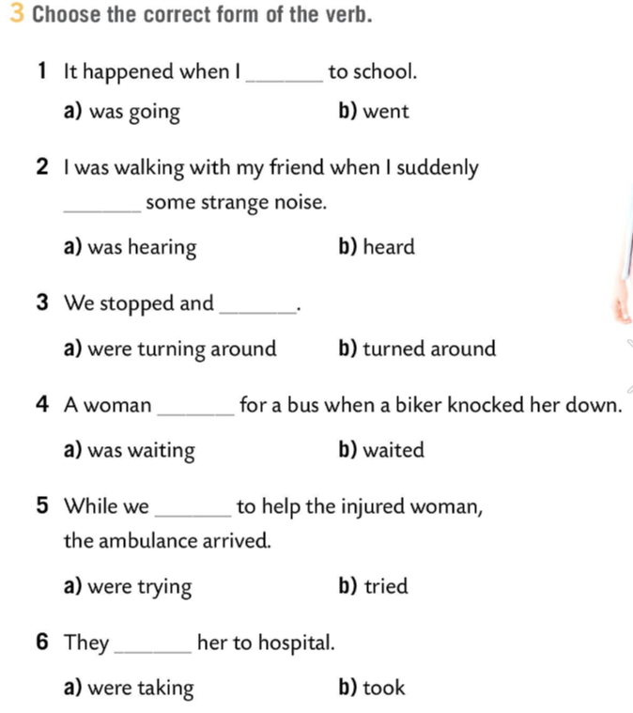
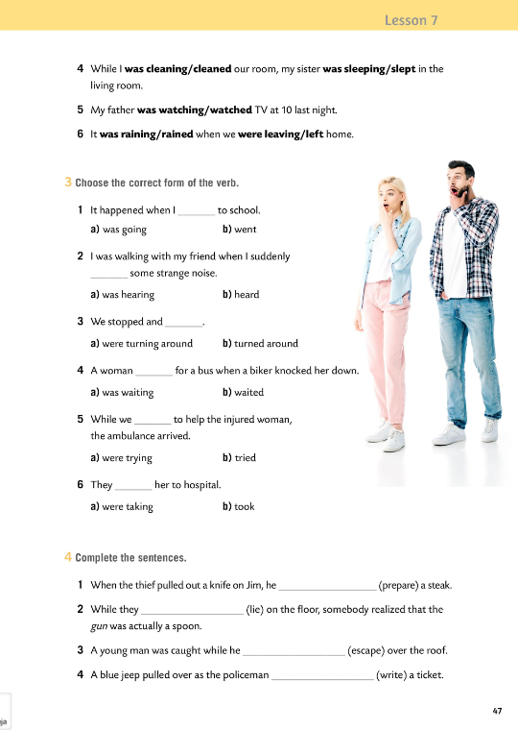
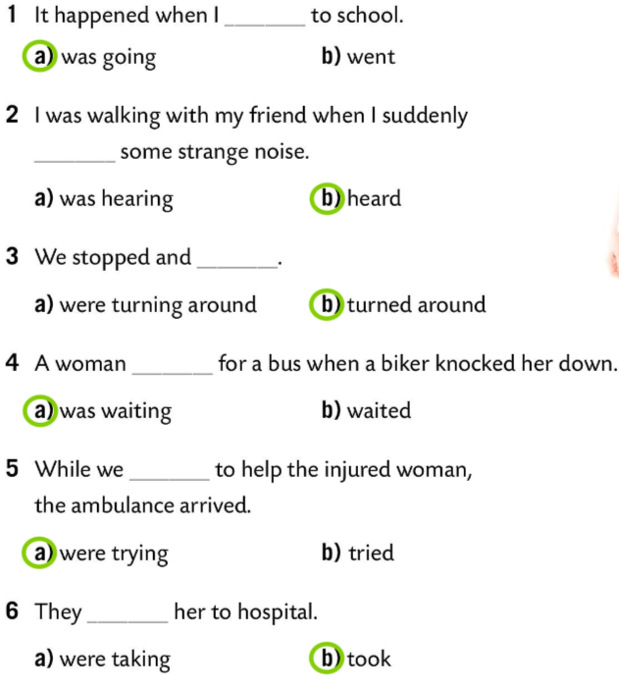
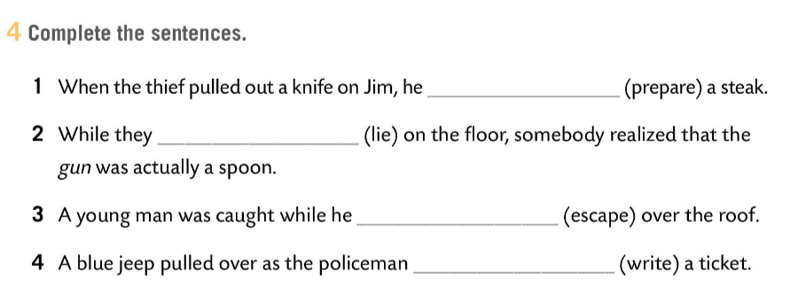
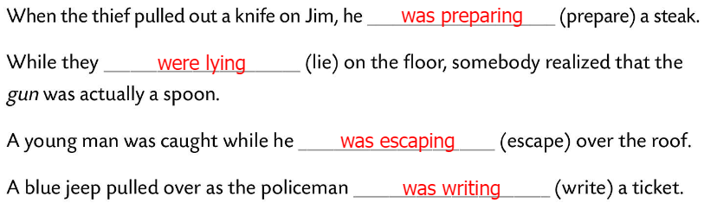
Workbook, p. 47
Choose the correct form of the verb.
Check.
Complete the sentences.
Check.

Slide 13
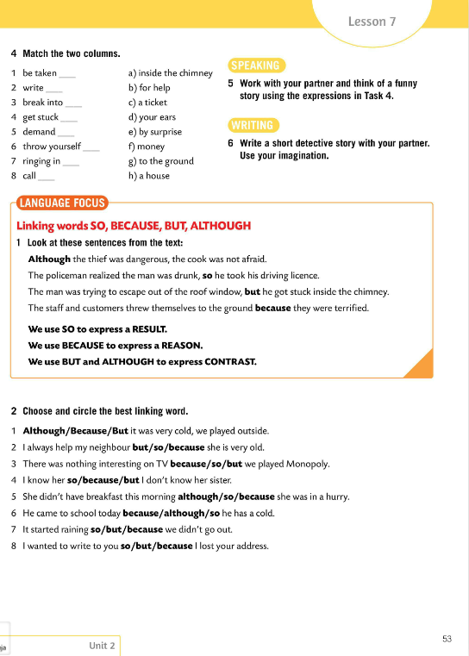
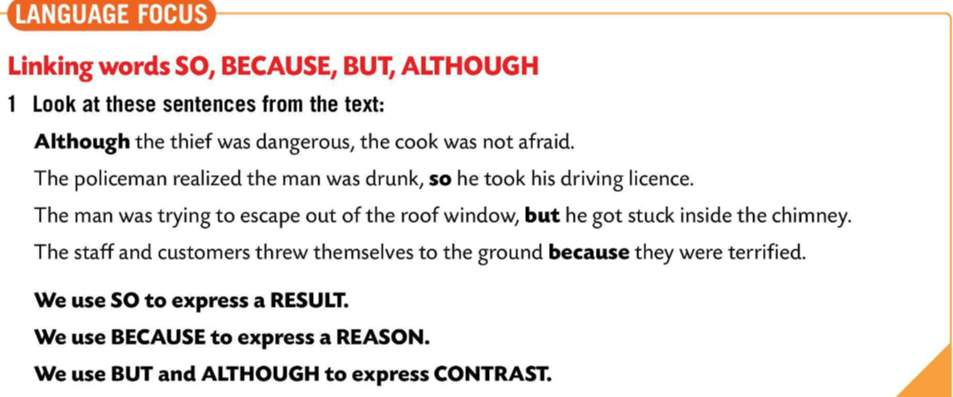
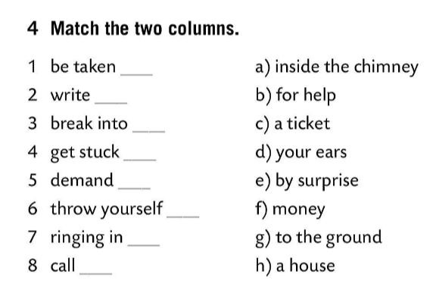
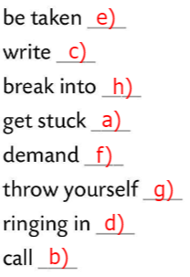
Match the two columns in Task 4.
Translate.
Speaking time! Work with your partner and think of a funny story using the expressions in Task 4.
Write a short detective story with your partner. Use your imagination.
LANGUAGE FOCUS
We use SO to express a RESULT.
Veznik SO (DAKLE) koristimo kada želimo izraziti posljedicu.
We use BECAUSE to express a REASON.
Veznik BECAUSE (zato) koristimo kako bismo iskazali RAZLOG.
We use BUT and ALTHOUGH to express CONTRAST.
Koristimo BUT (ALI) I ALTHOUGH (IAKO, PREMDA) za izražavanje suprotnosti.

Slide 14
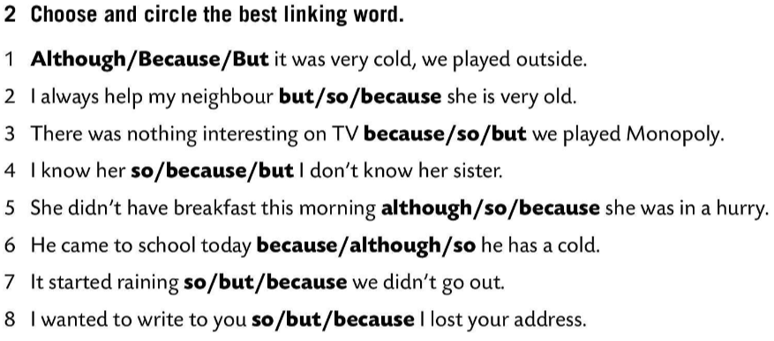

Choose and circle the best linking word.
Check.
Choose the correct from of the verb.
https://learningapps.org/watch?v=pqckdn9an20
Choose the correct linking word.
https://learningapps.org/watch?v=pv04pp69320

Slide 15




Workbook, p. 48
Finish the sentences using your own ideas.
Check in class.
Look at the picture of the classroom in Task 6.
What were the students doing when the teacher entered the classroom?
Check.

Slide 16





Workbook, p. 49
Read the text and fill in the gaps with ALTHOUGH, SO, BECAUSE (2x), BUT (2x).
Check.
Write questions for these answers.
Check.

